Slide 1
SOFTWARE QA ENGINEER - TEST CHALLENGE 2024
AUTOMATION –QUESTION -2

Slide 2
SCENARIO
Given the user is on the landing page for the WD site
And the Country filter is available
When the user selects “Belgium” from the Country filter list on the left panel
And click on Update button for the country filter list
Then the grid displays all meetings that are associated with the country “Belgium”
And no meetings associated with any other country appear on the list

Slide 3
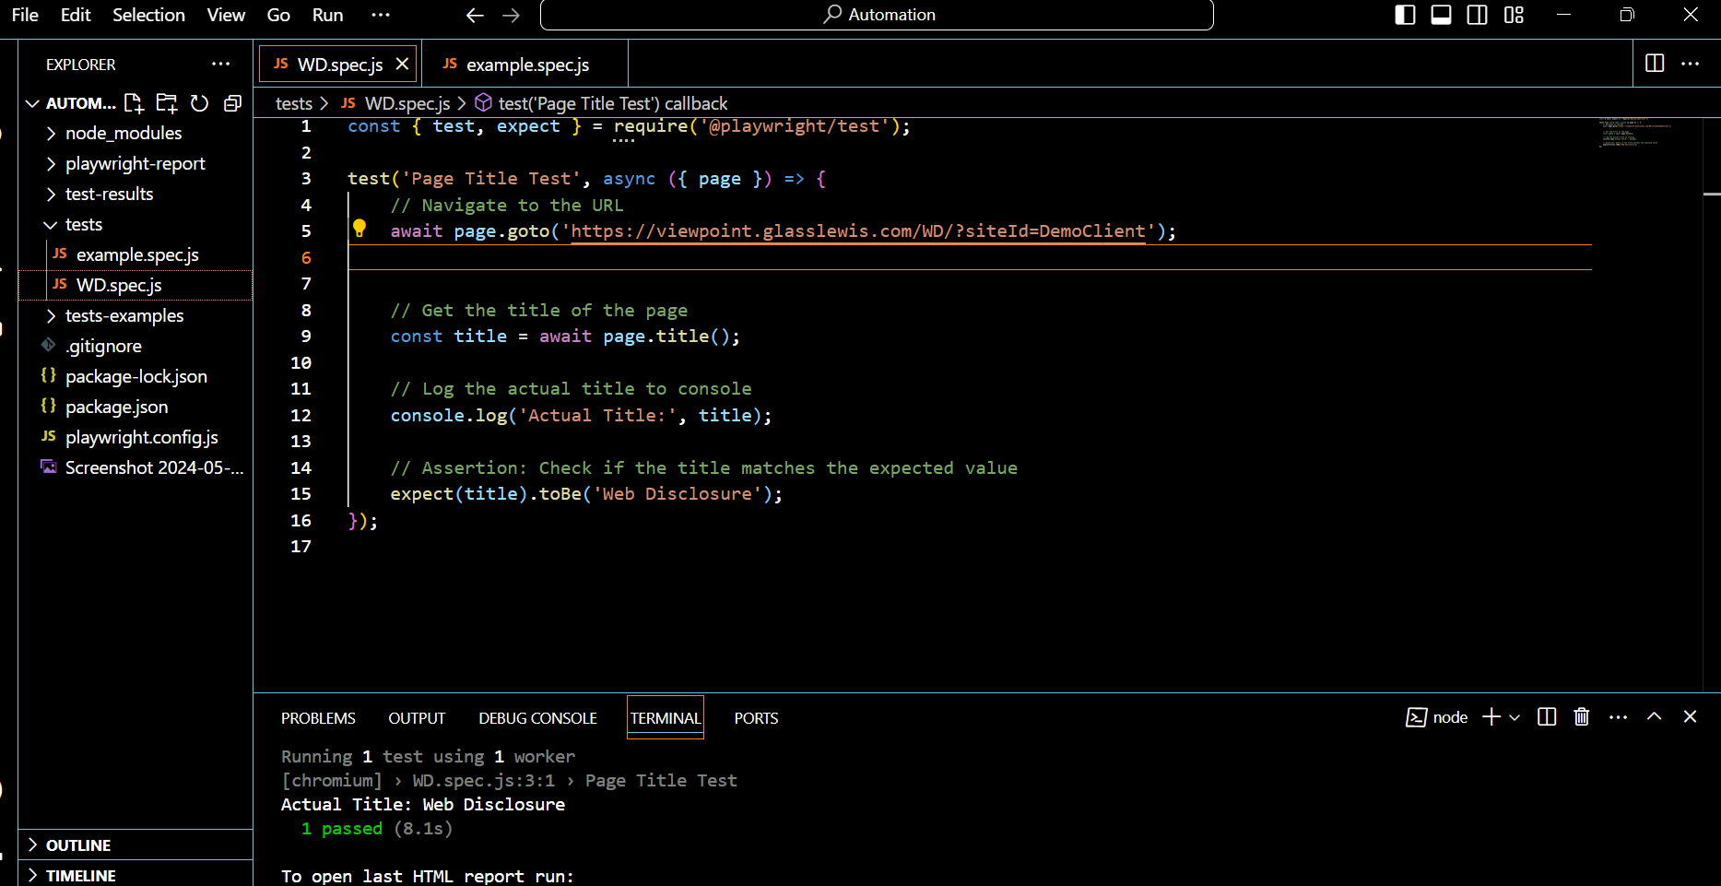
GIVEN THE USER IS ON THE LANDING PAGE FOR THE WD SITE
AND THE COUNTRY FILTER IS AVAILABLE

Slide 4
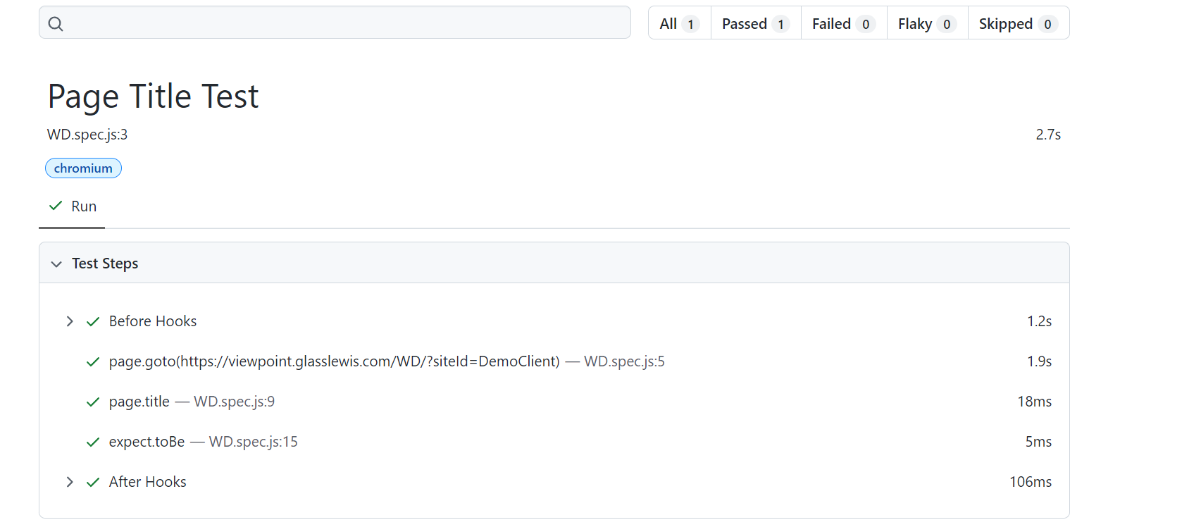
REPORT

Slide 5
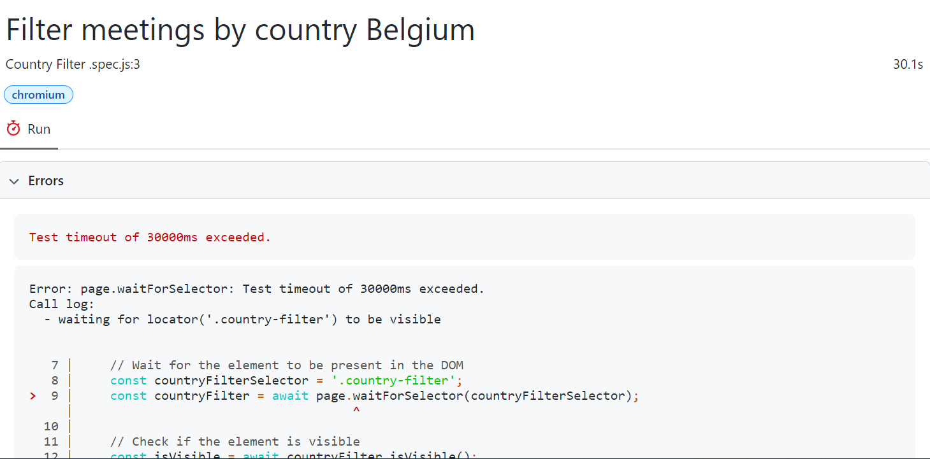
REPORT

Slide 6
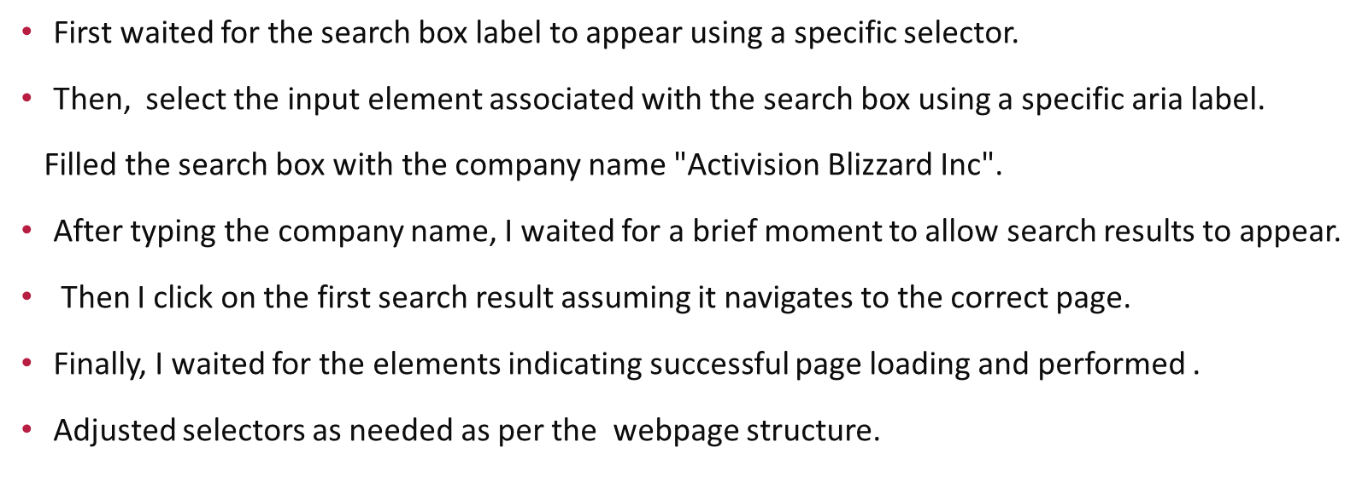
CODE WRITTEN BASED ON THE TESTCASE

Slide 7
TROUBLE SHOOT
The selector for the search box label 'label: has-text("Search for a company...")' is not matching any elements on the page, resulting in a timeout error.
I ensured that the label text "Search for a company..." exactly matches the text displayed on the webpage.
I tried the following steps to troubleshoot and resolve the issue:
Double-checked the label text to ensure it matches exactly what is displayed on the webpage.
Inspected the webpage using browser developer tools to verify the structure of the label and its associated input element.
Ensured that the page has finished loading before attempting to locate the label. Wait conditions to ensure the page is ready.
I still encountered the issue. Then using page.waitForXPath with an XPath selector to locate the label element.

Slide 8
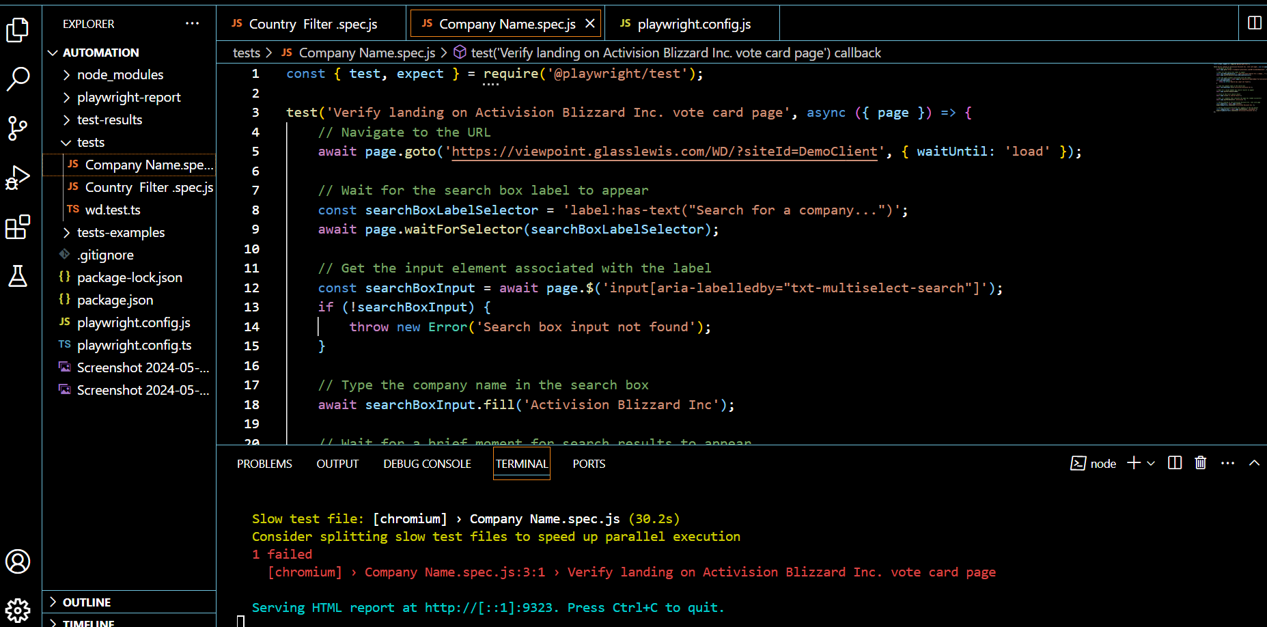
1-CODE-SEARCCHING FOR THE COMPANY NAME

Slide 9
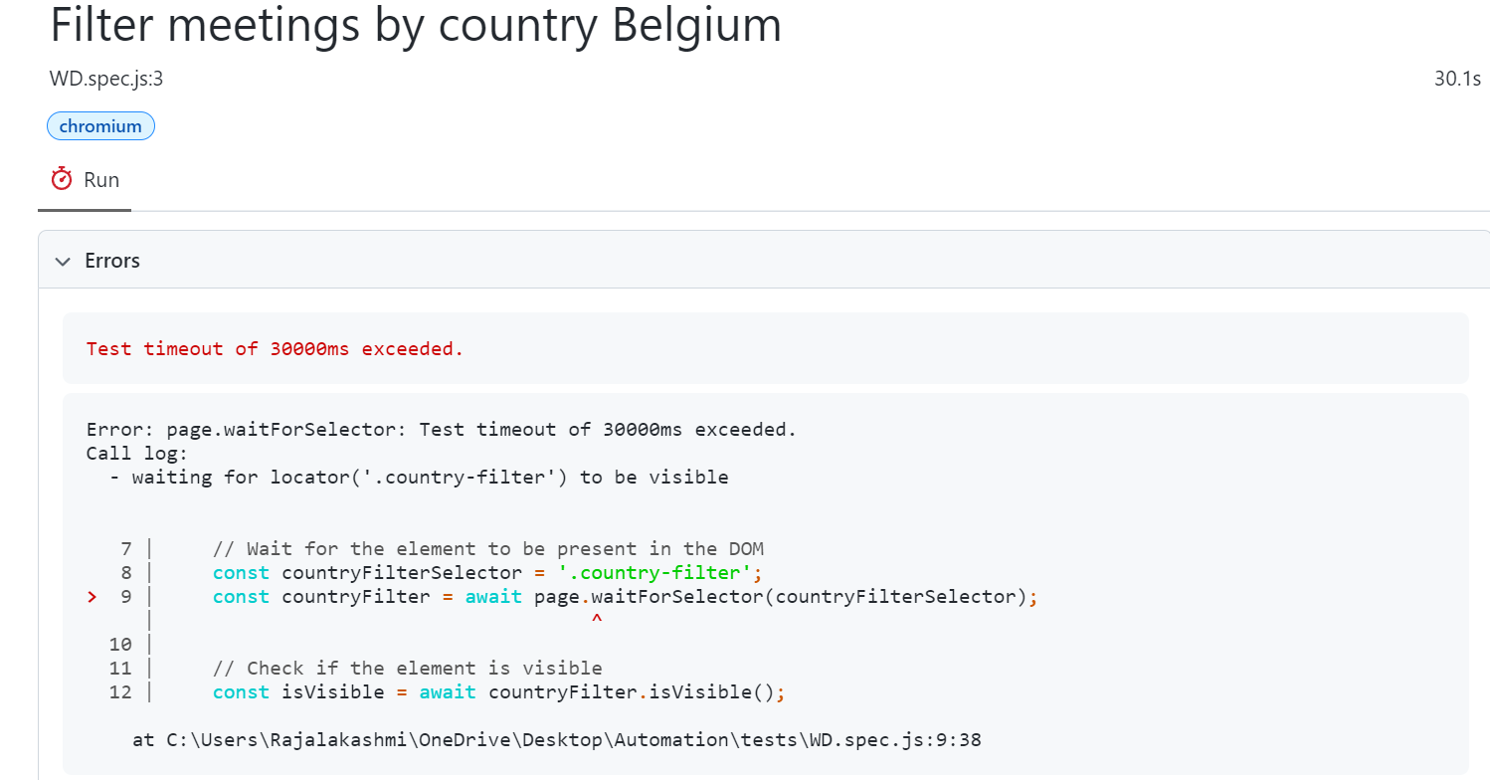
REPORT

Slide 10
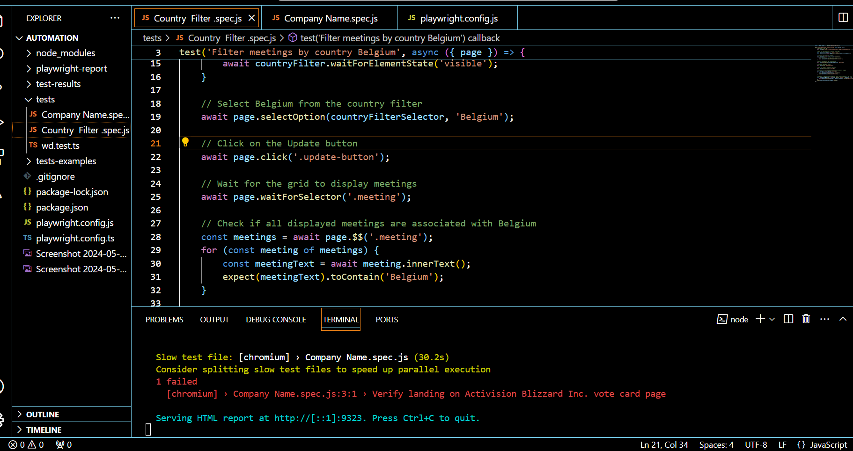
COUNTRY FILTER CODE

